Slide 1
mse of x when y is quantized
with 5e7 samples per sim

Slide 2
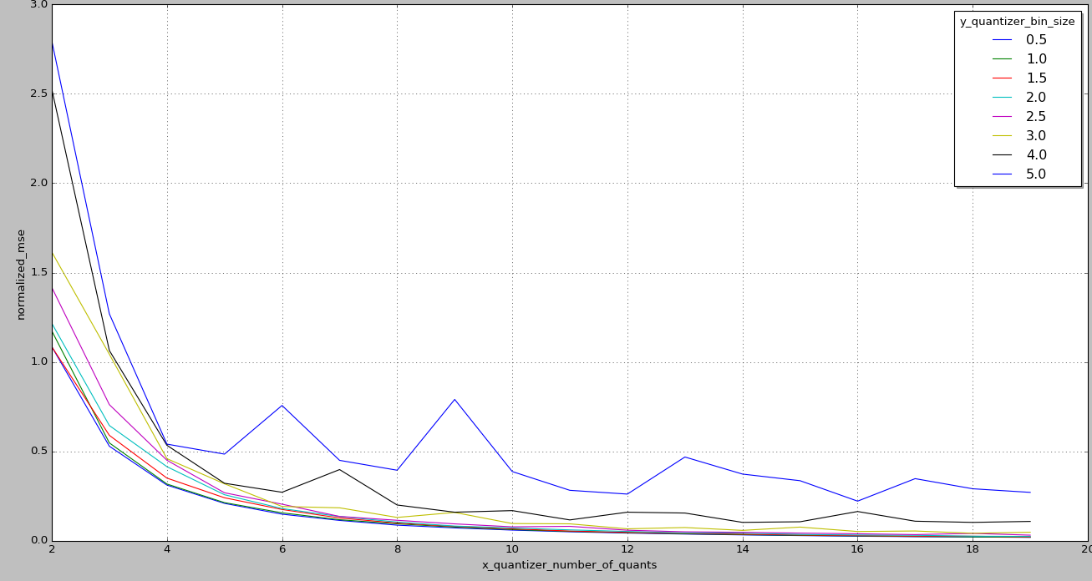
mse errors per x number of bins

Slide 3
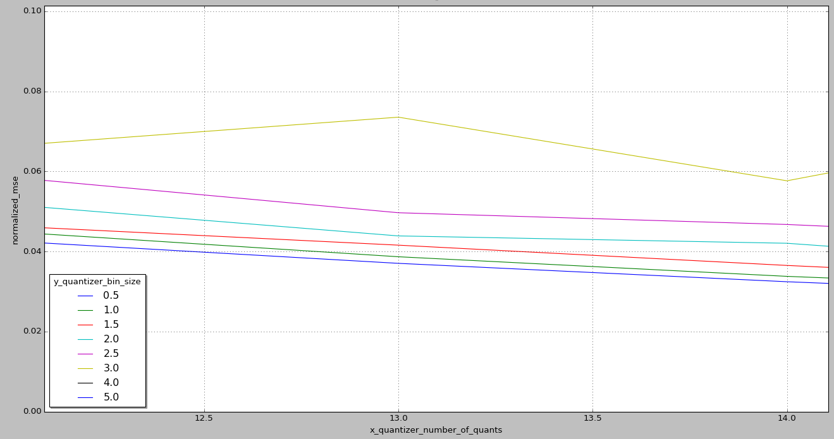
zoom in 12-14

Slide 4
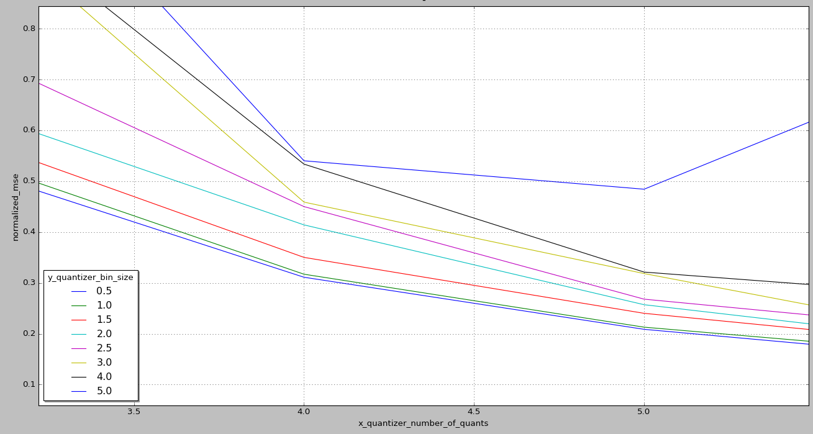
zoom in 3-5

Slide 5
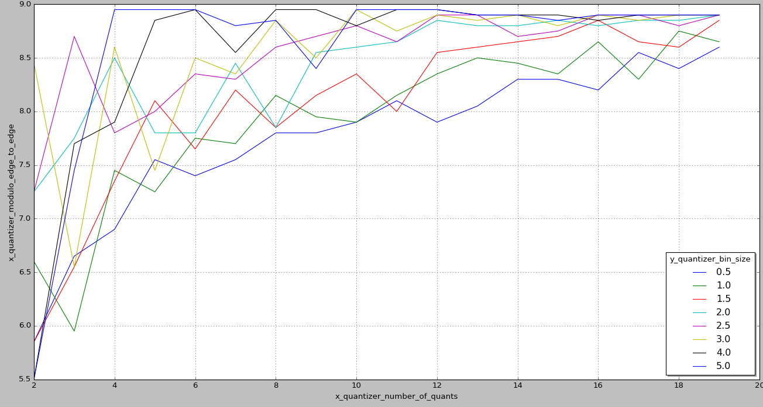
modulo size – errors at big y bin sizes
at bigger y bin sizes, the sim try to put bigger modulo, but I set the modulo size to be up to ~9 so we get big mse jumps at bigger y bin sizes

